Slide 1

The Black Death
Miss Anvieh

Slide 2
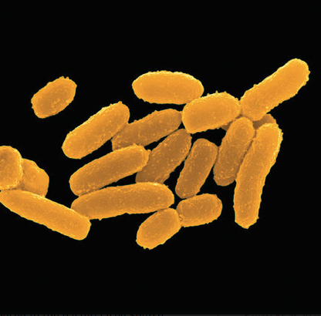
What is the Black Death?
Pandemic – highly infectious, spreading fast and wide.
Called “Black Death” because black rats that carried disease, but mostly due to the black lumps (buboes) that appeared on the skin.
The bacteria was discovered by Swiss researcher Alexander Yersina in 1984. He called it “Yersinia Pestis”

Slide 3
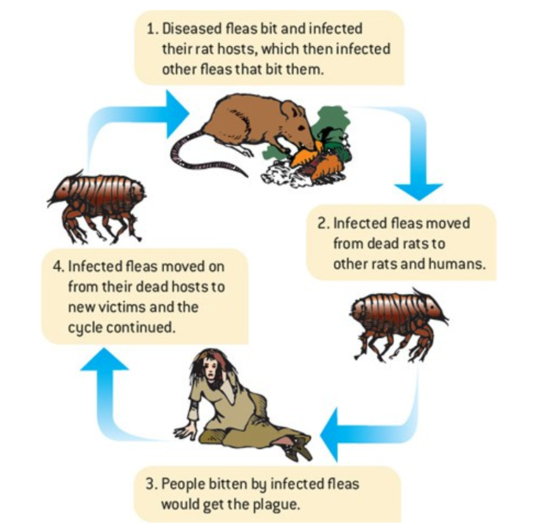
What is the Black Death?
French scientist Paul-Louis Simond showed it was fleas that carried the infection and they spread it when they bit the rats. When rats were scarce, they moved onto humans.

Slide 4
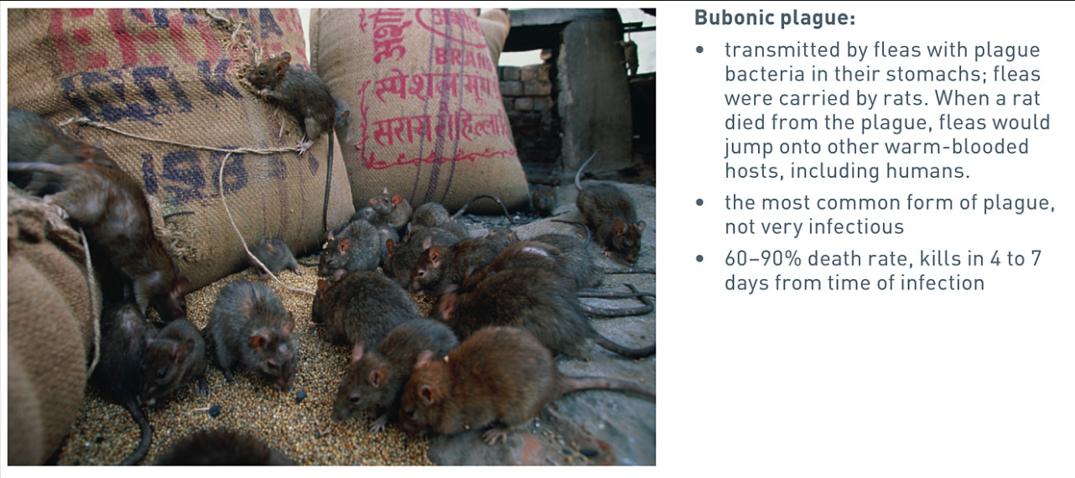
Three Different forms of plague

Slide 5
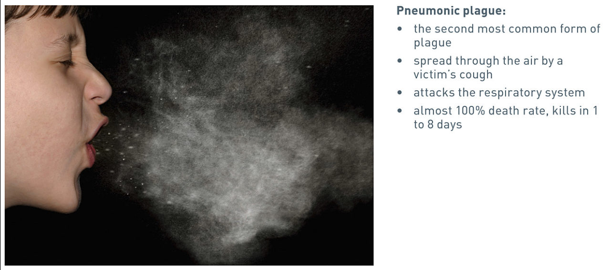
Three Different forms of plague

Slide 6
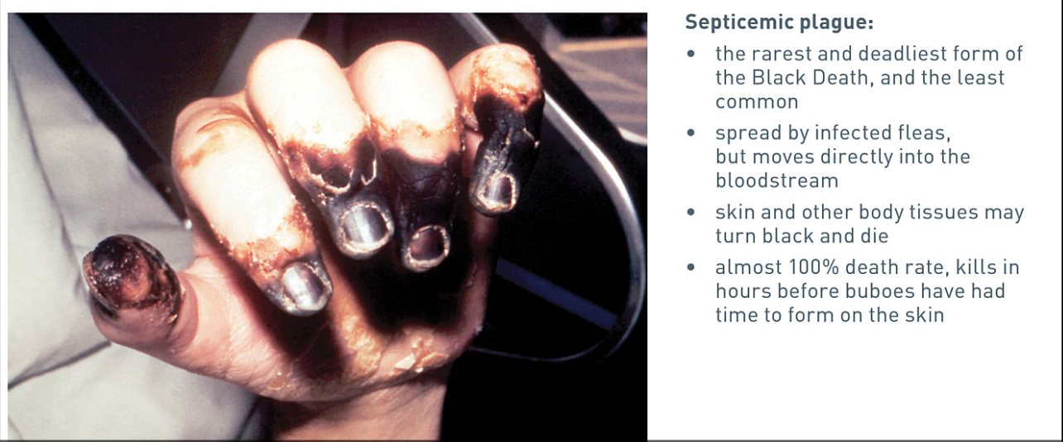
Three Different forms of plague

Slide 7
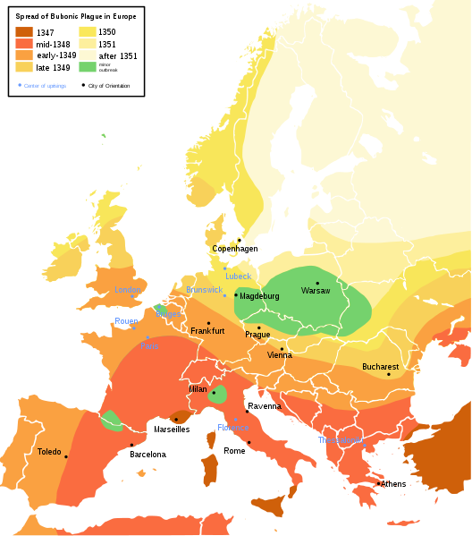
Origins
Historians differ over the first recorded plague epidemic. Some date it back over 3000 years ago in Babylon. It was present in Rome c550 AD causing many deaths however the 14th Century pandemic is thought to have originated in China c1320. This area was conquered by the Mongols, who carried it north to Mongolia who then travelled, making plenty of stops along the Silk Road to where it travelled east through towards Europe.

Slide 8
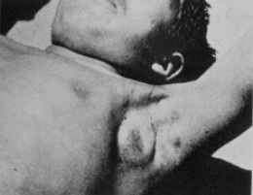
Symptoms
Fever, trembling, weakness, and profuse sweating are initial symptoms of the bubonic version.
The most distinctive sign is the agonizing rise of dark "buboes": sensitive black-blue swellings under the armpit and near the groin-spots where dead blood and pus builds up in the lymph nodes.
If the buboes are not pierced, the build up of infected blood will cause the buboes in the armpit and groin area to expand in size. Untreated, the patient will die from the build up of dead blood in these buboes.

